Slide 1
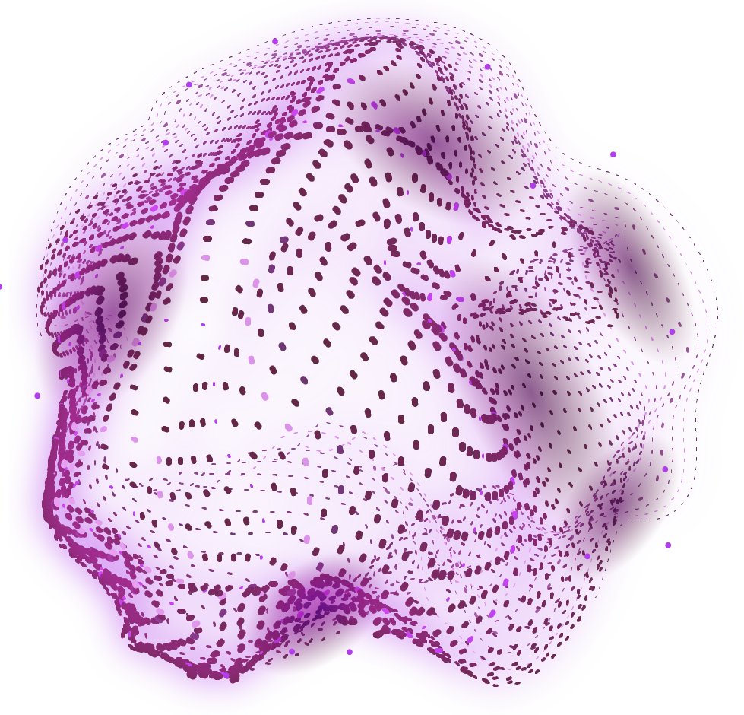
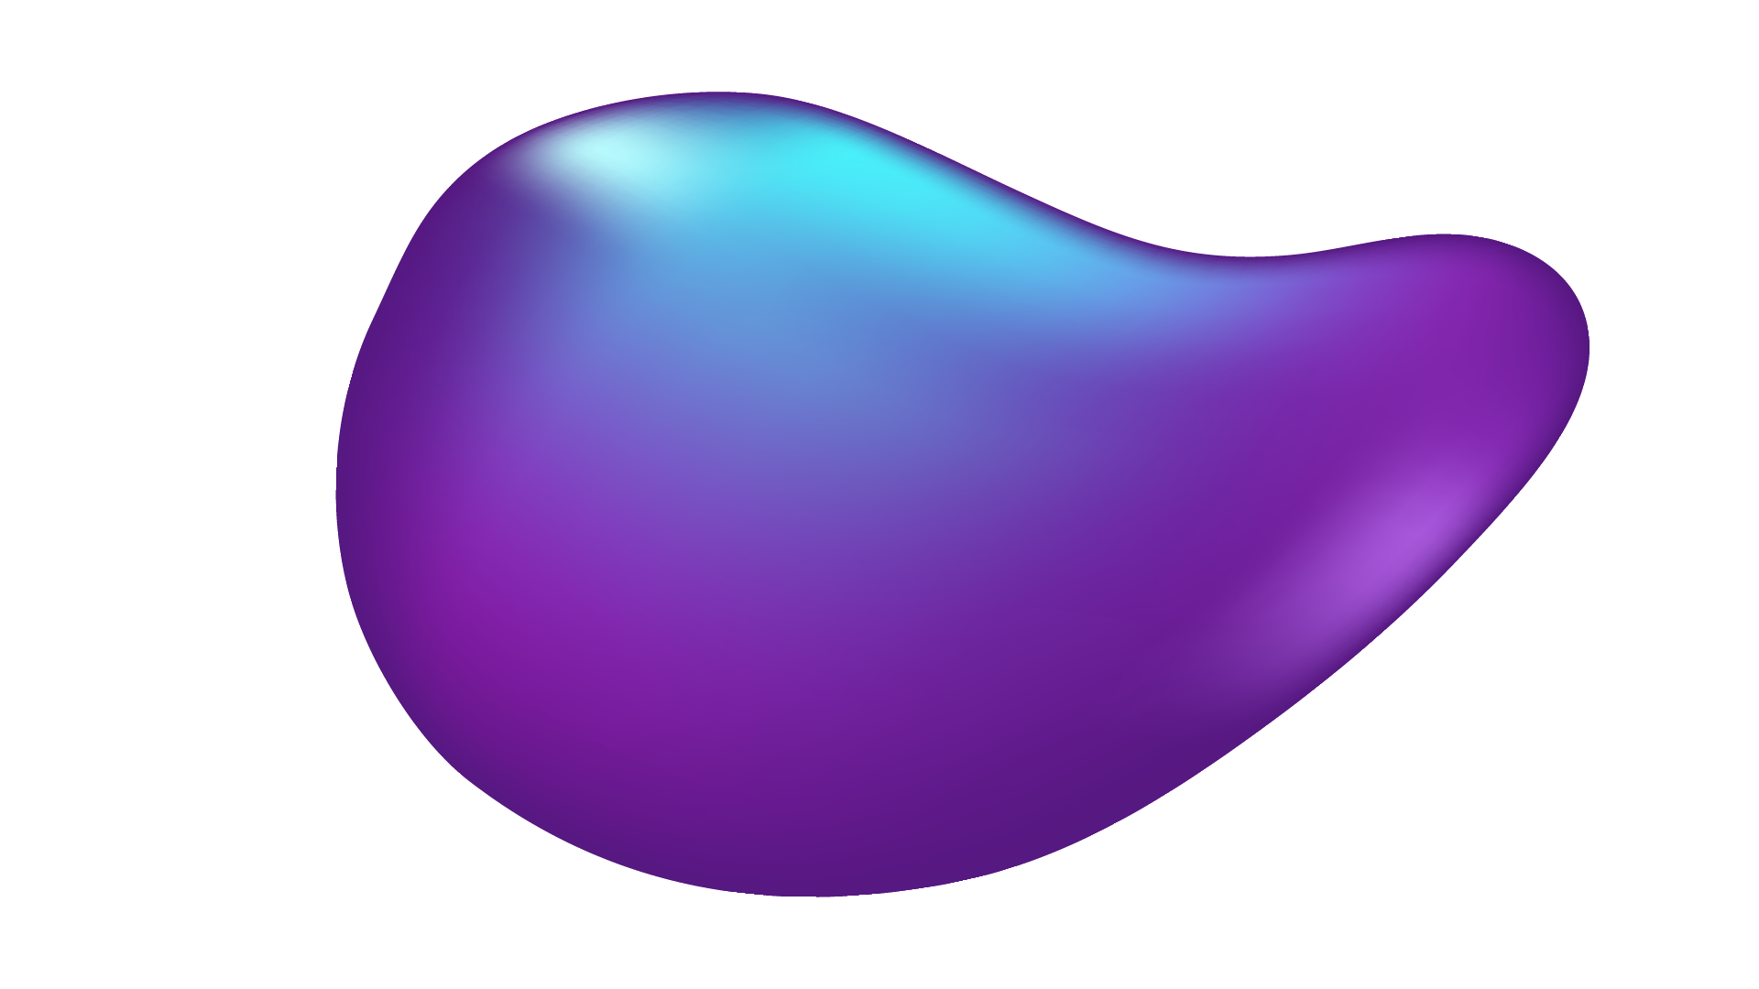

DEEPGUARD
MULTIMODAL DETECTION OF MANIPULATED DIGITAL CONTENT
Khadija Irfan 025
Zujajah Khan 031

Slide 2
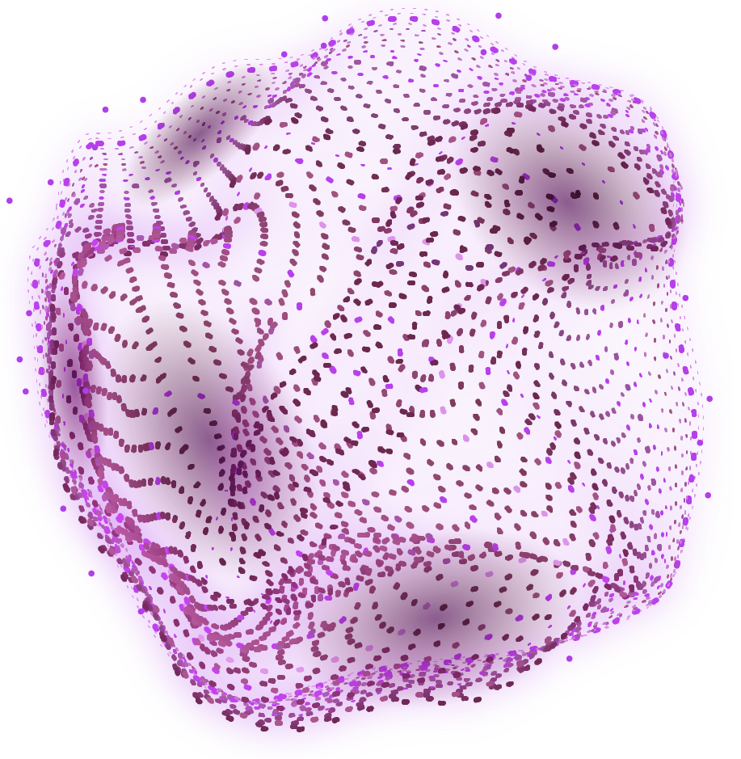
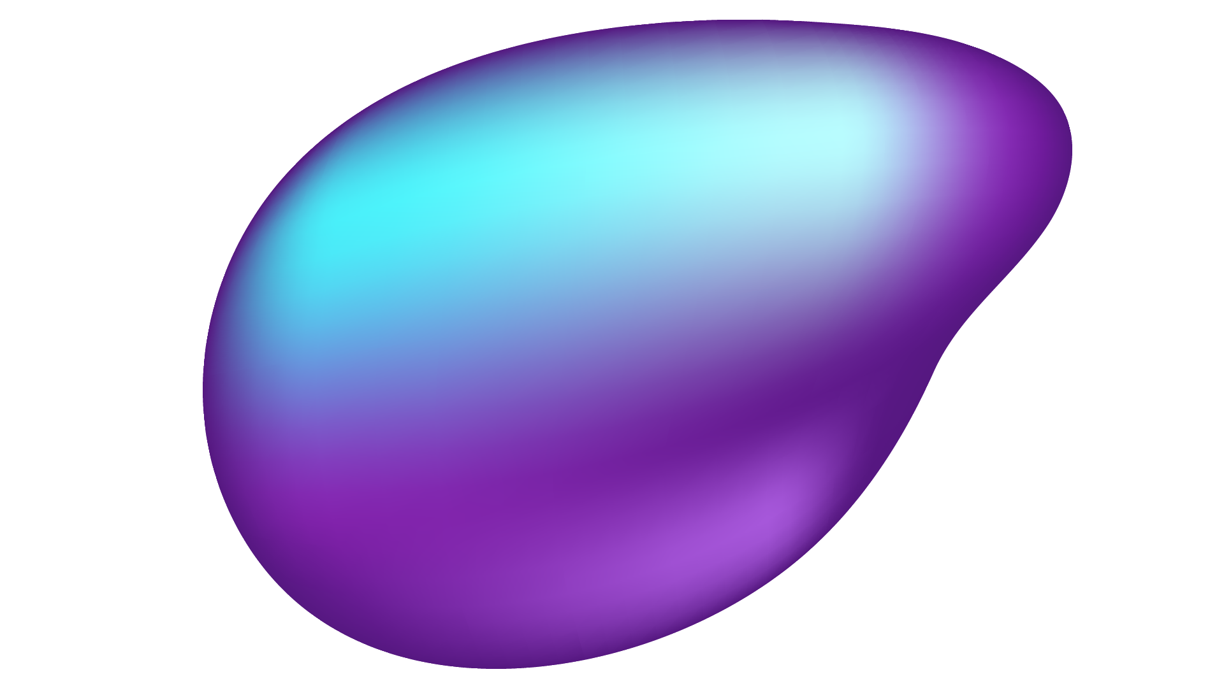
Introduction
Rapid spread of misinformation on social media
Text and images together can be misleading
Existing systems focus on single modality
Need for multimodal analysis with context checking

Slide 3
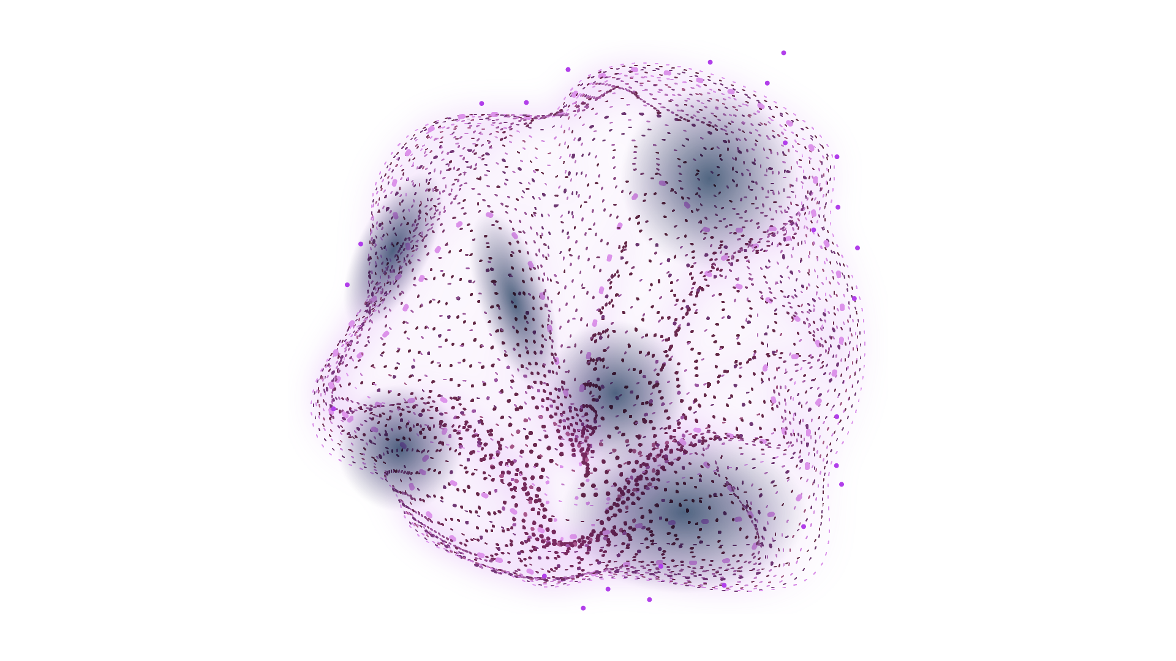
Problem Statement
Misinformation spreads rapidly online
Existing systems analyze text or images
Cannot detect mismatch between text and image
Need for integrated and context-aware system

Slide 4
Related Work
Text-based: SVM, BERT (only text)
Image-based: CNN, Deepfake detection
Multimodal: Combine features but limited interaction
Gap: Lack of context consistency analysis

Slide 5
Project Scope
Web-based application
Analyze text & image inputs
Provide prediction with confidence score
Basic explainability and user-friendly interface

Slide 6
Key Features
Context consistency checking
Sentiment analysis
Multimodal detection
Confidence score
Explainability

Slide 7
System Architecture
Input
Text Model
Image Model
Text + Image
DistilBERT
CNN
Sentiment & Metadata
Context Matching

Slide 8
Sustainable Development Goals (SDGs)
SDG 4: Quality Education (digital awareness)
SDG 9: Innovation & Infrastructure
SDG 16: Peace, Justice & Strong Institutions
Helps reduce misinformation impact

Slide 9
Methodology
Agile development approach
DistilBERT for text analysis
CNN for image analysis
Sentiment & metadata analysis
Context consistency checking

Slide 10
Milestones & Deliverables
M1: Setup & research
M2: Basic features
M3: Model development
M4: Context module
M5: Integration
M6: Testing & documentation

Slide 11
THANK YOU

